Slide 1
Fast Food Order System
Michael Morrison

Slide 2
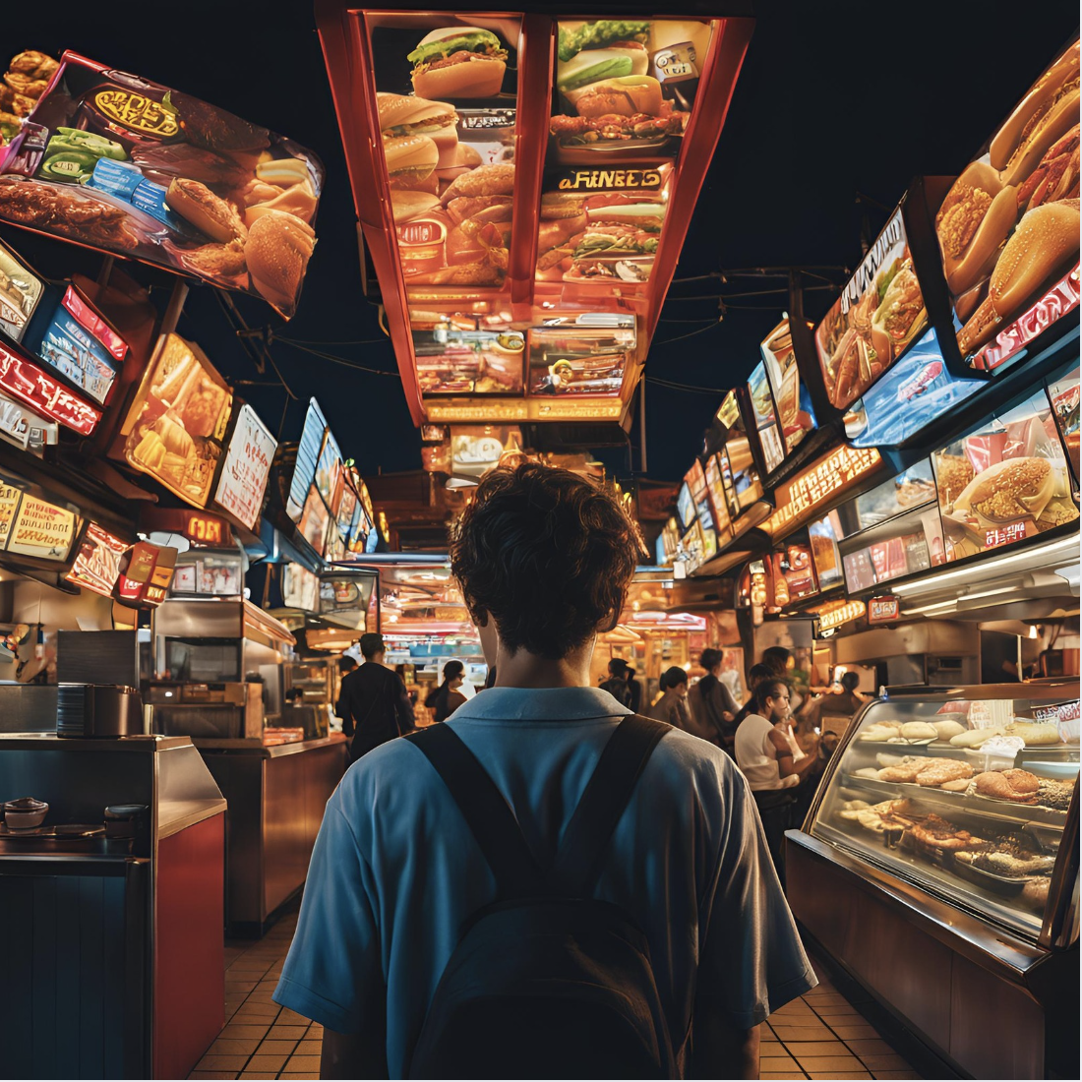
Business Problem
Services that allow ordering from fast food restaurants don’t allow direct comparison of items.
Goal:
Allow users to compare cost/calories across all restaurants
Allow store managers to view purchasing patterns
Allow root user to make changes to the restaurants that are in the system

Slide 3



Summary
The project will provide solutions on 3 fronts:
Customer:
Place orders
See past orders
Check rewards points
Find specific items
Get combo details
Manager:
Items ordered
Combos ordered
Total Earnings
Customers ordered
Add item
Add combo
Root:
Show tables
Total orders
Total earnings
Items ordered
Add restaurant
Add manager
Notes:
This is a short 2-3 sentence non-technical description of the solution

Slide 4
Solution
a. Schema Diagram of your implemented DB
Database Schema
b. High-level organization of your code
In VScode
c. How does your solution work & interact with your DB?
Python code interacts with a mysql database

Slide 5
Demo
To the code!

